Slide 1
Capstone Project: Analysis of Indian Cities
- Radhika

Slide 2
A: Introduction:
India, a country in South Asia, is the second-most populous country and the most populous democracy in the world, with the population of about 135.26 crores (2018). It has a population density of about 454.94 inhabitants per square kilometer.
With 29 states and 7 union territories, India is a place with enormous growth. In a diverse country like this, there is audience for almost everything, may it be art, science, sports, culture, technology or even farming. Along with the interesting history and mythology, the variety in the attire, nature, language speaks about the quality and versatility of life in the country.

Slide 3
A1: Description and Discussion of the Background:
Many students travel across the country for education, jobs, and to settle down. The main concern, whenever you move to a new city, is a house to stay in. Obviously, you will want to search for a good neighborhood, and this project, will give an idea as to how to select and what to choose, based on your requirements. The majority of the population in India is middle class.
Buying a real estate in a country as populated as India can be a real problem, especially when you have just started earning. Hence, rented apartments seem to be the new trend among the generation. The young generation does not prefer stability, and the short rent agreements allow you to move frequently. This analysis will also help the investors/ businessmen to decide where there is more scope.

Slide 4
The main cities in India are also the centers for the migrants, always looking for jobs. Hence, there can never be shortage of employees. Depending on the stream of the business/startup (tech, sports centers, education hubs, restaurants, and transportation), the choice of a city differs.
Pune is called as the education hub of India.
Mumbai is the city of dreams, the city that never sleeps.
Surat is called as the city of mirrors and mirages, a huge production centre.
Delhi, the capital of the country, is rich in everything, the historical places, the culture, and has tremendous scope for the government jobs.
The cities have mixed and intertwined structure. Comparing the nearby venues and the average rent values in each city, different categories of groups of cities can be made .

Slide 5
A2: Data Description:
To consider the above idea, I collected the data as mentioned below:
1. I used Foursquare API to get the most common venues in the top 5 cities.
2. I collected the average housing rent values of 106 cities from the link: https://www.makaan.com/price-trends
3. I used the geopy library to get the coordinates of each of the 106 cities and folium library to plot them on the map.

Slide 6
B: Data and Methodology:
As a database, I used GitHub repository in my study. The main data consists of the columns: City, 1bk_avg_rent, 2bhk_avg_rent, 3bhk_avg_rent, latitude, longitude information.
As a database, I used GitHub repository in my study. The main data consists of the columns: City, 1bk_avg_rent, 2bhk_avg_rent, 3bhk_avg_rent, latitude, longitude information and plotted them on the map, as shown below.

Slide 7
Results:
The following results were displayed by the code which is attached in the GitHub link for the notebook.
The screenshots of some of the results are inserted in the following slides.

Slide 8
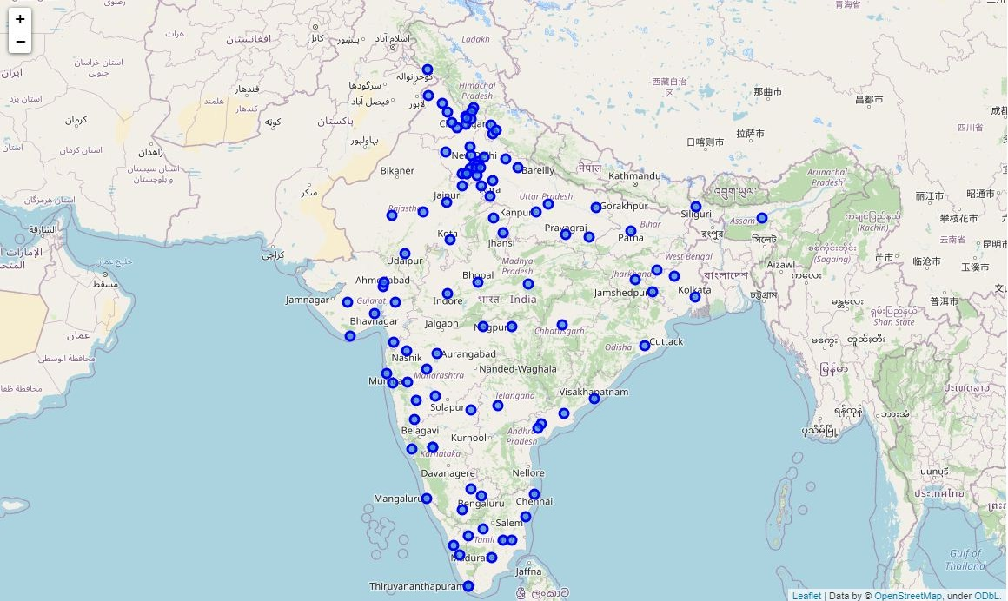

Slide 9
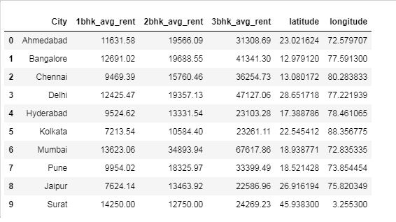
I then made a different dataframe for the top 10 cities.

Slide 10
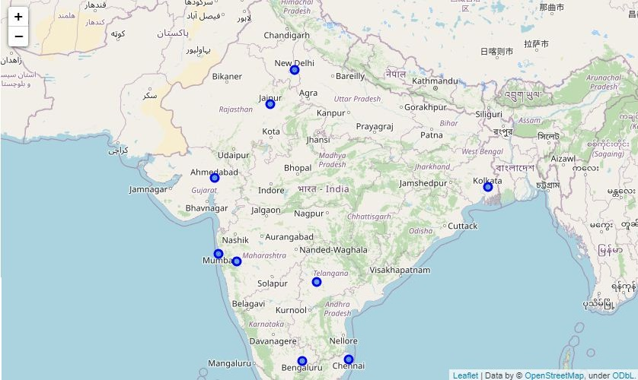
I then plotted them on map too.

Slide 11
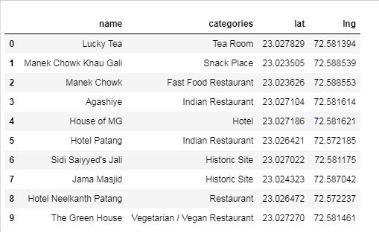
I utilized Foursquare API to explore the venues of top 5 countries. I set the radius 500m and the limit 100 for each. The venues of the following cities were returned by Foursquare API: 1. Ahmedabad:

Slide 12
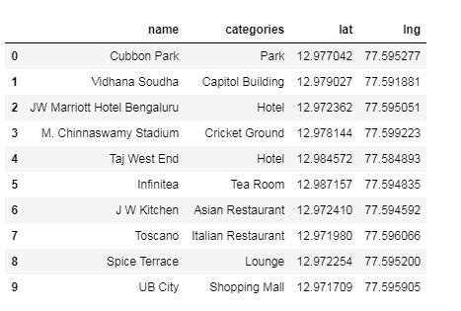
2. Bangalore:

Slide 13
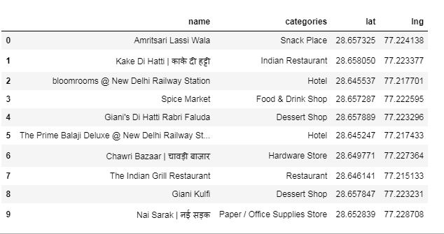
3. Delhi:

Slide 14
4. Mumbai:

Slide 15
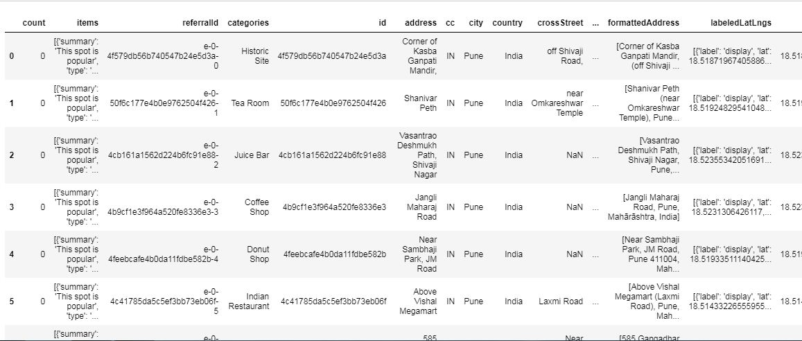
5. Pune:
* We can increase the number of venues with more latitude longitude information.

Slide 16
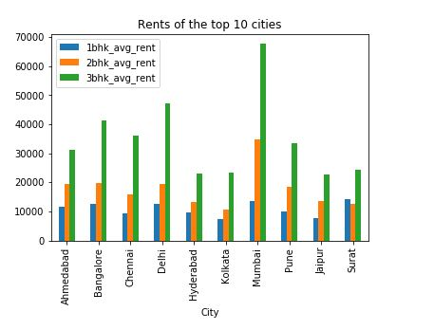
Understanding the trend of rents is important. Usually, the most common rented apartments are 2bhk. The multiple bar chart of the rents of the top 10 cities is as below:

Slide 17
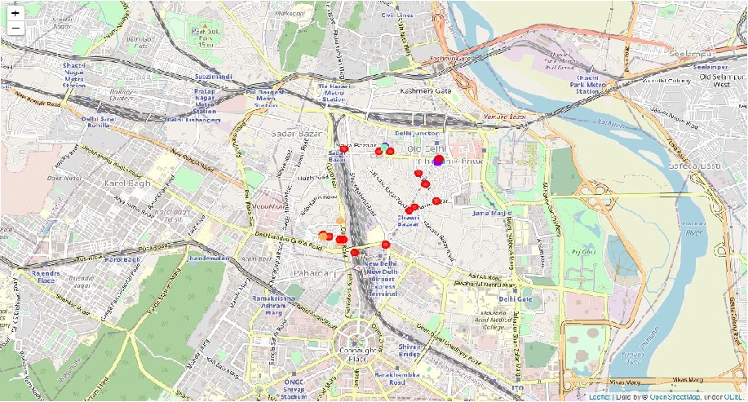
Using one hot encoding to the venues data gotten from Foursquare enables you to make clusters. I have done one for Delhi.

Slide 18
Observations and Discussion:
All these cities have adaptable neighborhoods, covering almost all the necessities.
Being a resident of Pune, I personally would recommend the city to the investors, as there are a lot of opportunities here. The rents data will help the common man who wants to move here.
There are other factors like weather, financial and job opportunities, education, family needs, which differ from person to person, hence the audience has to prioritize their needs and may choose this project to decide the city they want to move in.

Slide 19
Conclusion:
What comes to your mind when you hear the name ’India’? Definitely culture, world heritage, food, etc.
India is one of the fastest growing economies.
The above analyzed 5 cities are the safest cities to live in, having the best quality of life. I have tried to tell you the which are the best cities to live in according to various factors.
I used the methods taught in the series of courses.
THANK YOU!

